Slide 1
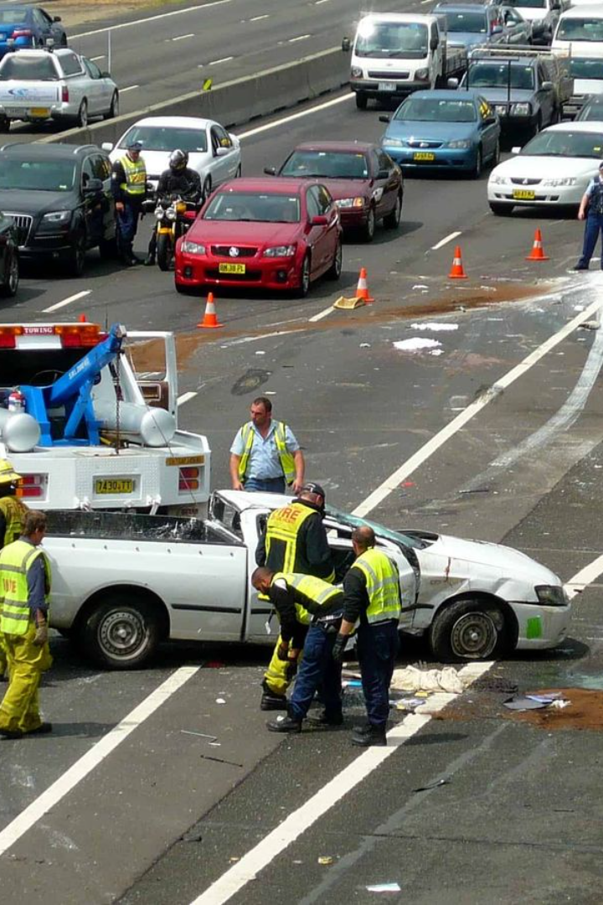
Portfolio Project - Road Accident Analysis On Power BI
By Nakul Sharma - Data science Aspirant

Slide 2

Steps In The Project
1
Requirement Gathering
Identified KPIs and visualizations needed, and stakeholders in the project.
2
Data Processing
Data was cleaned, processed, and modeled to yield insights and cater to the requirements.
3
Data Visualization / Chart Design
Designed graphical representations using Power BI’s features and offered an exceptional reporting system.

Slide 3
Project Requirements
Primary KPI
Secondary KPIs
Casualties by Road Type for Current Year
Total casualties and total accident values for the current year and year on year growth, and total casualties and total accident severity for the current year and year on year growth.
Total casualties with respect to vehicle type for the current year and monthly trend showing comparison of casualties for the current and previous year.
Also, current year casualties by area/location and by day/night and total casualties and total accidents by location.

Slide 4


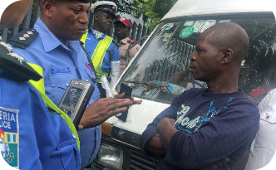

Stakeholders
Ministry of Transport
Police Force
Road Safety Corps
Public
Responsible for enforcing legal regulations and preventing accidents through monitoring and regulation.
Protects and saves lives on the road and aims to reduce the number of road fatalities and injuries through campaigns and initiatives.
Is affected by road accidents, and their opinion and participation are essential in promoting road safety.
Oversees regulation of transport and its agencies, and is involved in the planning and funding process of transport infrastructure.

Slide 5

Data Overview
The dataset used was UK’s Road Accident Dataset, an excel file containing comprehensive data on road accidents that occurred throughout regions in the UK for 2021-2022 including climatic conditions, the severity of injury caused to casualties, and more data.

Slide 6
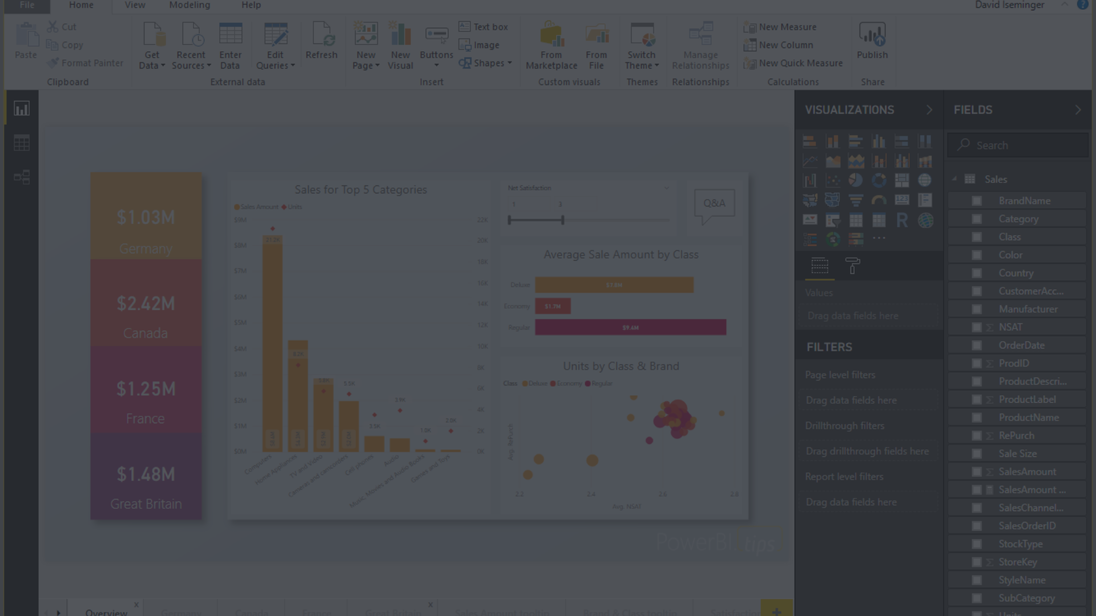
Power BI Functionalities
How to connect raw data / flat file
Data cleaning in Power Query Editor
Data processing using Power BI
Time management functionalities / calendar data table in Power BI
Data modeling (relationship between multiple tables).
Year-Time Date, Year to Year growth calculations using DAX
KPI and advanced KPI generations according to requirements and creating custom columns and measures in reports
Importing images/vehicle images
Creating different charts and generating insights
Exporting the report to users and viewers.

Slide 7
Conclusion
1
Summary
2
Gratitude
The analysis of UK's Road Accident Dataset through Power BI was highly captivating, informative, and visually engaging. The report was intuitive and actionable, and the insights we found will aid in promoting road safety.
Thank You for viewing and supporting me in my journey in the world of data. I will keep trying best to make more such projects.

